Slide 1


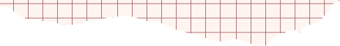





Digital portfolio
STUDENT NAME :J.HAFZANA FARVEEN
REGISTER NUMBER:24134130500122007
NMID :C01AFFE71423F578F874C1D5C0C6C2E3/
ASANM:41341324213007
DEPARTMENT:BCA-II
COLLEGE:DEEN COLLEGE OF ARTS AND SCIENCE

Slide 2




STUDENT
DIGITAL
PORTFOLIO

Slide 3

1.Problem Statement
2. Project Overview
3.End Users
4.Tools and Technologies
5.Portfolio design and Layout
6.Features and Functionality
7. Results and Screenshots
8.Conclusion
9. GitHub Link
AGENDA:

Slide 4



PROBLEM STATEMENT
The Traditional resume often fails to fully capture a student's skills and project work,making it difficult for
them to stand out employers and academic institutions

Slide 5

PROJECT OVERVIEW
To Create an interactive Digital portfolio Website that allows a Students to professionally showcase their academic projects,technical skills and personal achievements in a Visually appealing and Organized Manner

Slide 6


Who are the End Users?
Students:
The Creators of the Portfolio,who want a professional to prevent their works
Recruiters/Hiring Manager:
Professionals who need to quickly asseses a candidate's abilities and project abilities
Academic Institutions:
Admission officers evaluating applicants for graduation programs

Slide 7
TOOLS AND TECHNIQUES
Your paragraph textsoftware/tools used to build the project.
Example:HTML,CSS,Javascript ,VS Code,GitHub

Slide 8
PORTFOLIO DESIGN AND LAYOUT
DESIGN
Simple Colour scheme:
The Portfolio uses a limited colour palettes for aa
professional and clean look Visual Hierarchy:
Different font sizes and weights are used to guide the user's eye emphasize key informationg

Slide 9
LAYOUT
Clean, minimalist and responsive:
The Overall Layout is uncluttered and adopts well
to the different screen sizes
Header:
The Top of the page includes the student's name,a brief
tagline and a navigation bar Dedicated Sections:
The Content is organized into a separate sections, eachwith its own clear heading like "About" and "Projects"

Slide 10
FEAUTURES AND FUNCTIONALITY
FEATURES
Project Showcase:
A section for students to display their works including title, description,links to the projects and it's code
Skill Highlights:
A simple and updatable lists of technical skills
Professional Contact informations:
A Section with contact details and links to professional profiles like LinkedIn, GitHub

Slide 11


FUNCTIONALITY
Interactive Navigation:
The Navigation provides a smooth scrolling animation when links are clicked, instead of an abrupt jump
Responsiveness:
The layout adjusts to.a different screen sizes, ensuring
a good user experience on both desktop and mobile devices

Slide 12
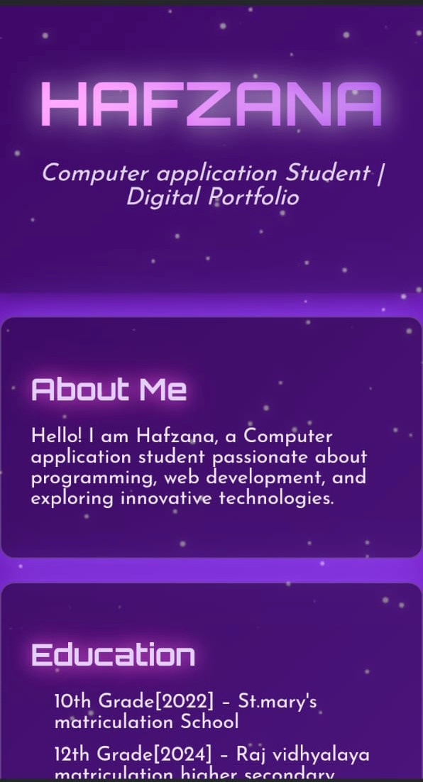
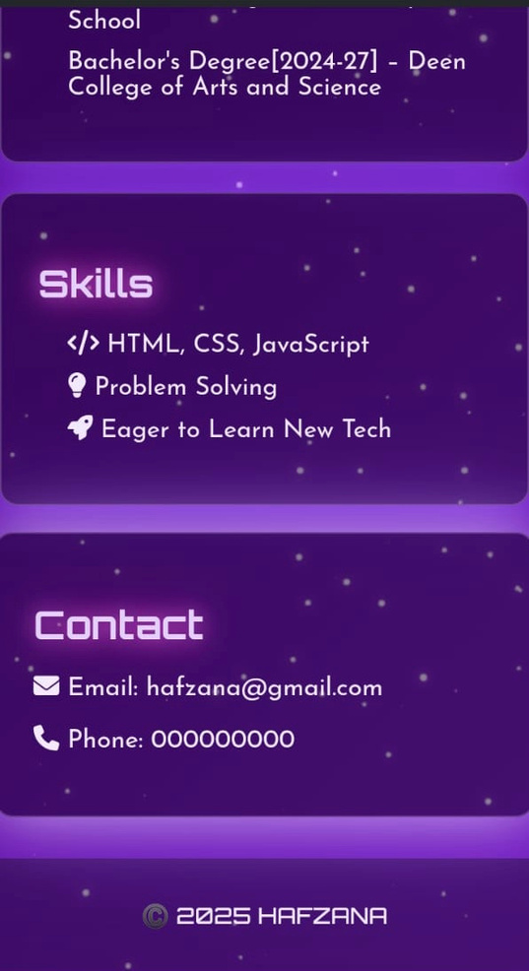

Slide 13
CONCLUSION
Highlights of projects:
Hafzana ‘s Projects, a Student management system and a code editor,show her pratical skills in both front- end and back- end development
Benefits to society:
Her Project offers a real world benefits from improving school administration to helping programmers work more efficiently
Final Summary:
This portfolio effectively proves Hafzana’spotential as a software developer by showcasing her foundationalknowledge and applied project skills
?

Slide 14
GITHUB LINK
https://github.com/Hafzana-Jerish123/J.Hafzanafarveen-TNSDC-FWD-DP.git

Slide 15



THANK
YOU

